Slide 1
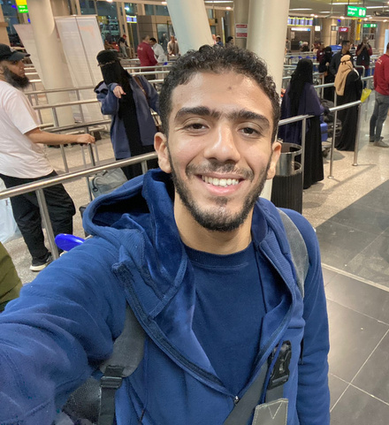
Hello, my name is
Mahmoud
Anter
Digital Marketer

Slide 2

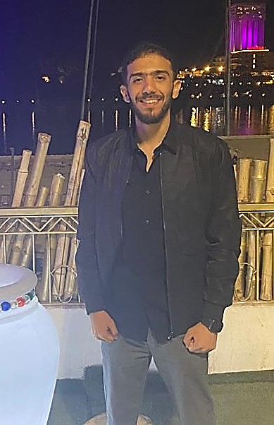
Creative Portfolio
Mahmoud
Anter
Welcome to my world Highly passionated person about marketing and content creation that leads to boosting your sales, with Perfect market Researches about competitors that help me tobuild strong relationship with your customers and understand your target audience make content strategic plan and content that help you to grow rapidly have good experience in content writing and articles

Slide 3
Creative Portfolio
Mahmoud Anter
EDUCATION BACKGROUND
2020
2024
Faculty of commerce
Digital marketing diploma

Slide 4

Creative Portfolio
PERSONAL
SKILLS
Digital Marketing Strategy
Social Media Marketing
Content Creator
Branding
Analytics and Reporting
Copy writing

Slide 5



Creative Portfolio
Mahmoud Anter
My projects
It is time to show you some of my writings in different fields

Slide 6
Creative Portfolio
Mahmoud Anter
Content in digital marketing includes
articles, videos, images, and , enhancing brand engagement
Attracting the target audience.
Building trust and relationships with customers.
Enhancing engagement and driving conversions and sales

Slide 7



Creative Portfolio
Posts
Mahmoud Anter

Slide 8
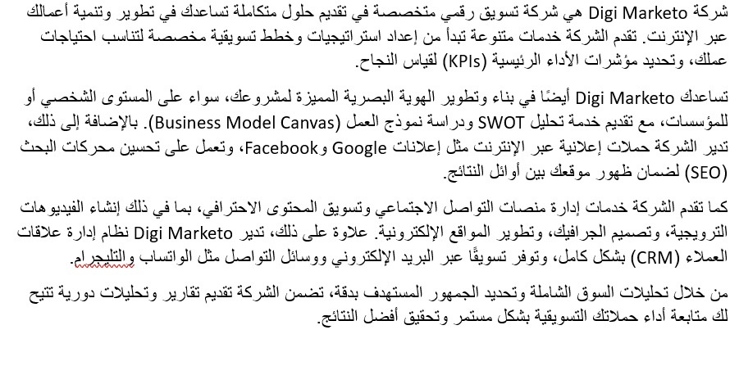
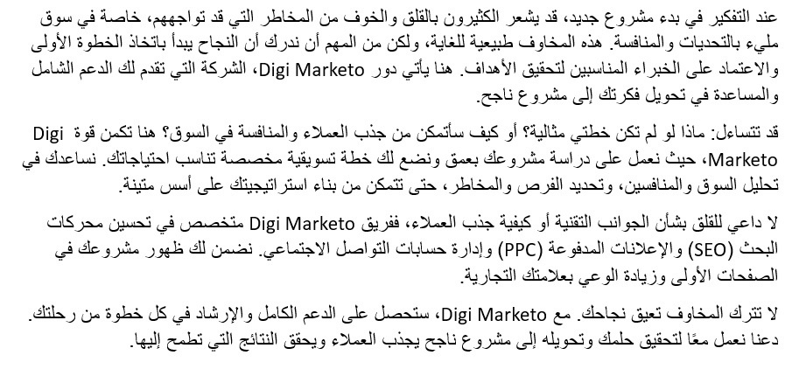
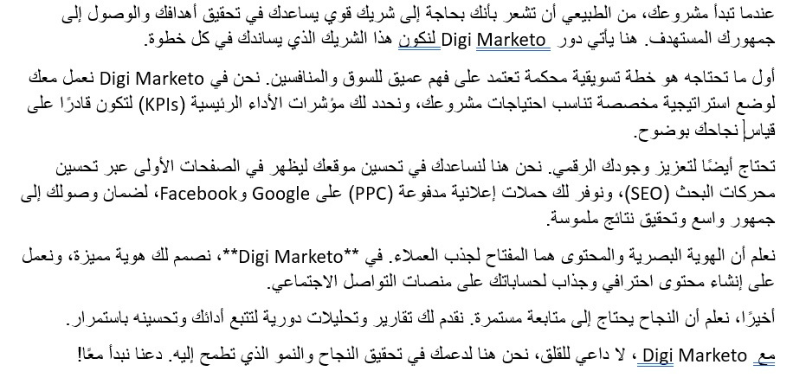
SEO Articles
Creative Portfolio
Mahmoud Anter

Slide 9
Creative Portfolio
Mahmoud Anter
كتابة محتوي خاص بمجمع طبي يحتوي علي عدة مقالات وصور والمواعيد الخاصة للحجز والحضور
جذب الجمهور المستهدف .
بناء الثقة والعلاقات مع العملاء.
اقناع العملاء بالمنتجات لزيادة المبيعات.

Slide 10
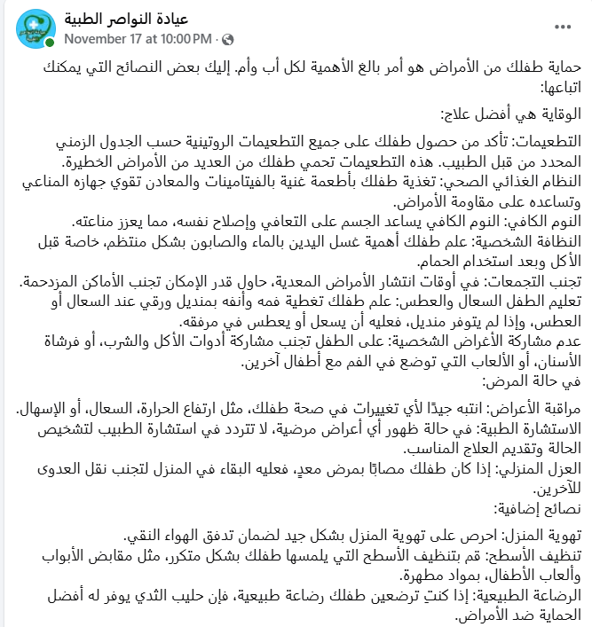
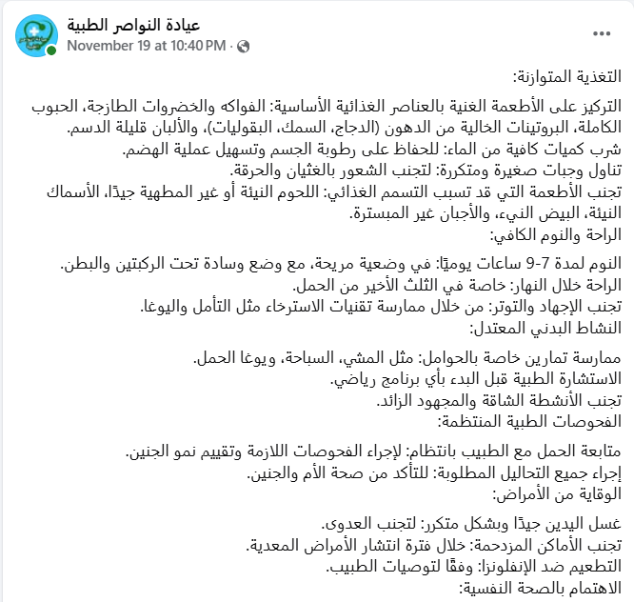
Creative Portfolio
Articles
Mahmoud Anter

Slide 11

Creative Portfolio
Mahmoud Anter
Let's work
TOGETHER
mahmoudanter489@gmail.com
www.linkedin.com/in/mahmoud-anter-123641163
+201151853023

